Slide 1


Literature Survey
Ernest Chianumba, Blessing Austin-Gabriel, Rolih Ferdinand, Cristian Noriega Monsalve

Slide 2

Hybrid CNN-LSTM and Domain Modeling in Climate-Energy Analysis for a Smart Environment
Literature Review
GOAL
Predict net energy generation based on the temperature and identify interdependencies for smart cities
Correlation between power generation and temperature – local / state level
Hybrid approach CNN-LSTM, domain knowledge in Environmental Science
Python’s Sckit Learn is used for the implementation

Slide 3
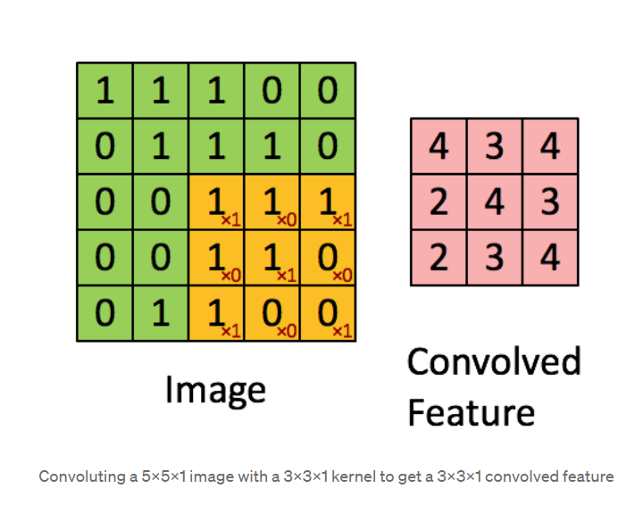
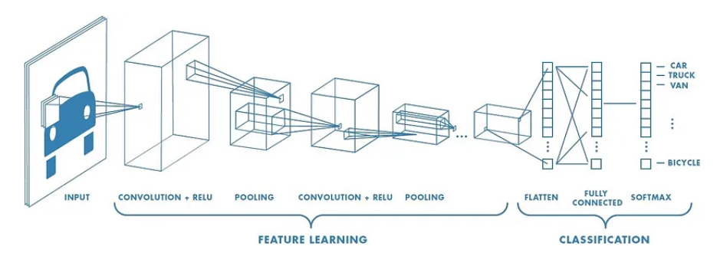
Convolutional Neural Networks (CNN)
Deep Learning algorithm that:
takes in an input image
assign importance (learnable weights and biases) to objects in the image
Identify features and predict them
CNN is used for image processing in object recognition

Slide 4
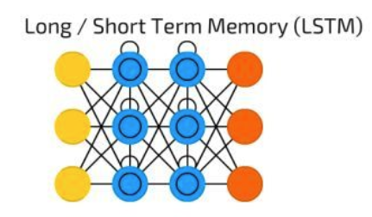



Long-Short Term Memory (LSTM)
Memory cell for storing Long-term information and gates (forget, input, and output)
Forecasting, analysis in time series and sequential data tasks (language processing, speech recognition, etc)

Slide 5
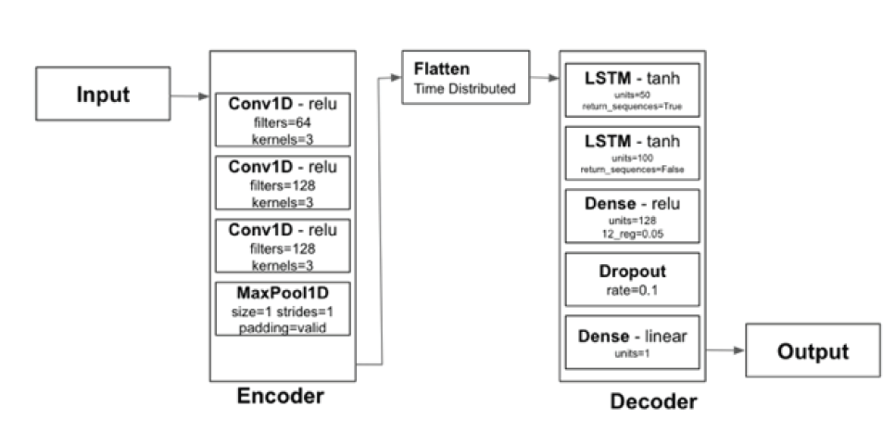
CNN-LSTM TO PREDICT NET ENERGY GENERATION FORECASTING
CNN: categorize weather conditions:
3 layers to analyze the data, then amplify its features
LSTM: learn solar power generation:
3 layers, uses learned weights to make complex decisions based on the extracted features

Slide 6
References
S. Shrestha, B. Buckley, A. S. Varde and D. Cwynar, "Hybrid CNN-LSTM and Domain Modeling in Climate-Energy Analysis for a Smart Environment," 2023 IEEE 35th International Conference on Tools with Artificial Intelligence (ICTAI), Atlanta, GA, USA, 2023, pp. 229-233, doi: 10.1109/ICTAI59109.2023.00041. keywords: {Climate change;Convolutional neural networks;Electricity;Long short term memory;Predictive models;Smart devices;Smart cities;Power generation;CNN;Climate Studies;Electricity;Energy;LSTM;Predictive Modeling;Smart Environment;Smart Cities},
https://towardsdatascience.com/a-comprehensive-guide-to-convolutional-neural-networks-the-eli5-way-3bd2b1164a53

Slide 7
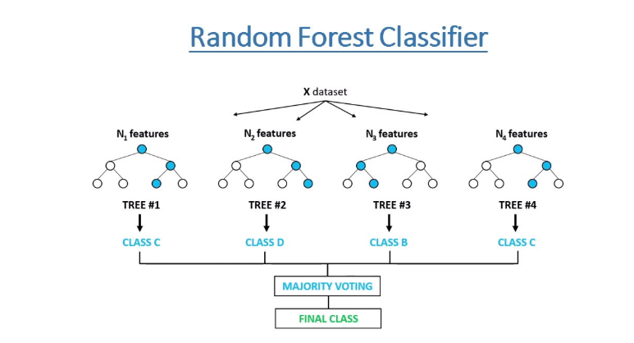
Leveraging Machine Learning for Diabetes Prediction
Literature Review
GOAL OF THE ANALYSIS
The paper utilizes the PIMA Indian Diabetes Dataset for its analysis. We delve into the effectiveness of the Random Forest algorithm, augmented by feature selection methods, to predict diabetes more accurately.
This dataset is a well-known resource in machine learning for diabetes research and consists of several medical predictor variables and one target variable, Outcome.
The predictors include the number of pregnancies, glucose concentration, blood pressure, skin thickness, insulin level, BMI, diabetes pedigree function, and age.
These parameters are used to predict whether a patient has diabetes (indicated by 1) or not (indicated by 0), based on diagnostic measurements.

Slide 8
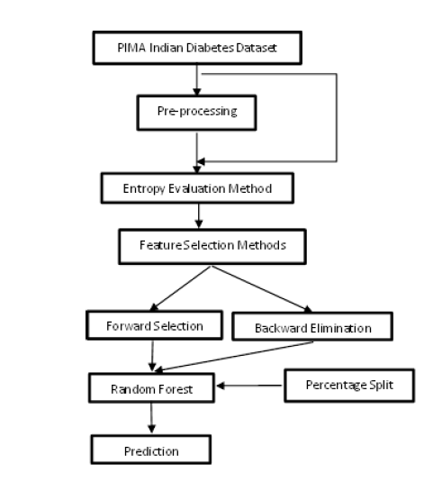
The Framework
Performance evaluation of the Random Forest algorithm across various feature subsets determined by the feature selection methods.
Identification of the feature subset that leads to the highest classification accuracy, demonstrating the efficacy of combining Random Forest with feature selection for diabetes prediction.
Implementation of entropy-based feature selection techniques, including:
Forward Selection: Iteratively adds features that improve model performance.
Backward Elimination: Iteratively removes the least significant features.
Forward selection iteratively adds features that enhance model performance, while backward elimination iteratively removes the least significant features.

Slide 9
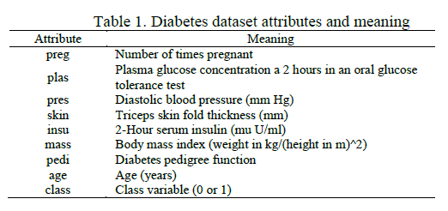
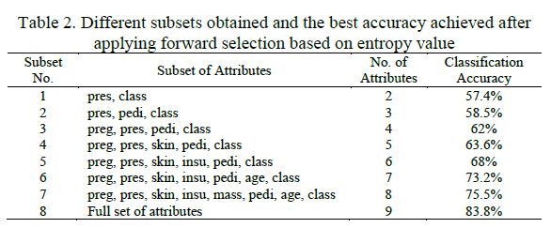
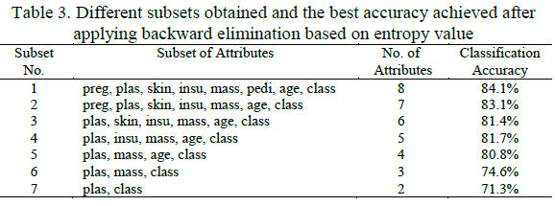
In this section, the paper presents the outcomes of the research work, which involves the application of data mining methods, specifically Random Forest, in conjunction with feature selection methods, such as forward selection and backward elimination, on the diabetes dataset.

Slide 10
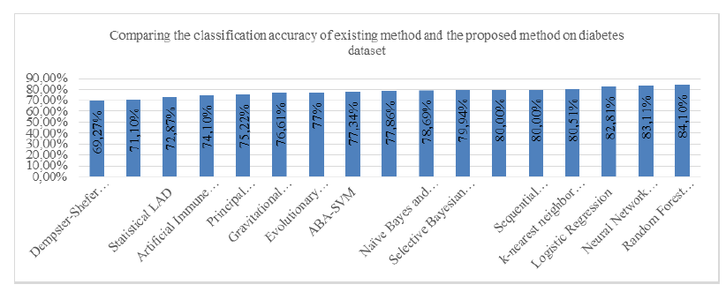
Results
Baseline Accuracy: The paper reports a baseline classification accuracy of 83.8% achieved using the full set of attributes in the diabetes dataset.
Feature Selection Impact: The study demonstrates a significant improvement in classification accuracy to 84.1% when employing feature selection methods, namely forward selection and backward elimination.
Key Attributes: This enhanced accuracy is achieved with only 7 specific attributes: "preg," "plas," "skin," "insu," "mass," "pedi," and "age." These attributes are found to be particularly influential in diabetes prediction.
A comparative analysis shows that the proposed approach outperforms other models or techniques applied to the same dataset. This visually reinforces the effectiveness of feature selection in enhancing diabetes prediction.

Slide 11
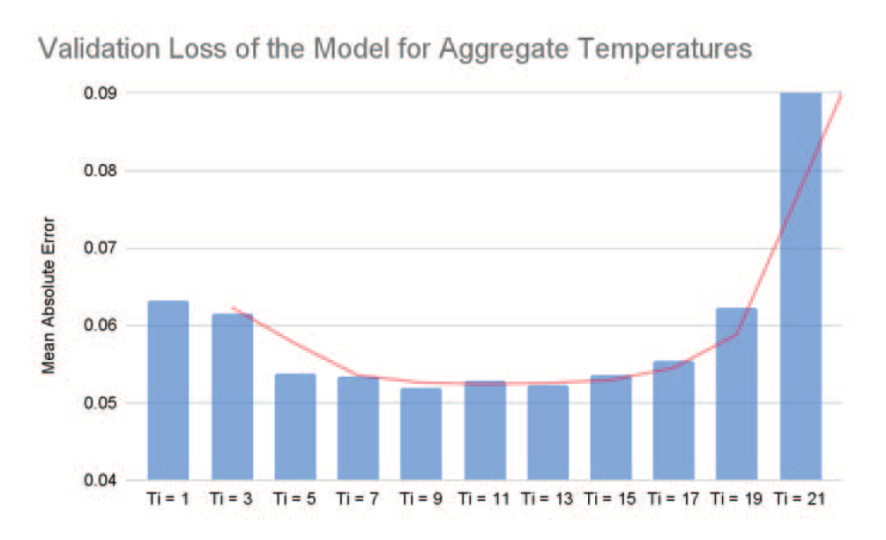
Smart Cities with AI
Machine Learning
CNN-LSTM diversification
9 to 13 temperature readings on the power plant have a better performance across the model
Real-time temperature allows dynamic adjustment in energy generation controlling greenhouse gas (GHG) emissions

Slide 12
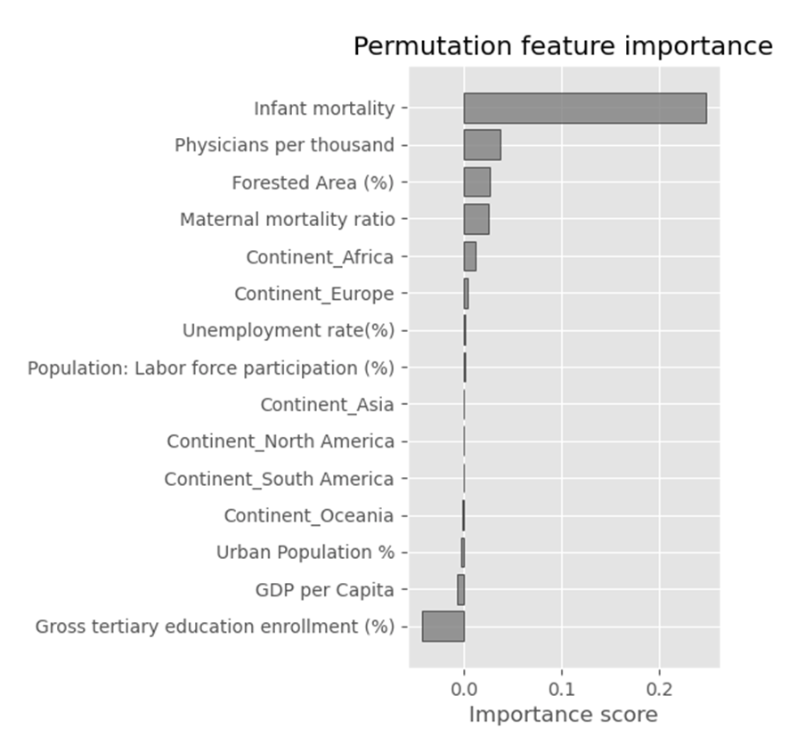
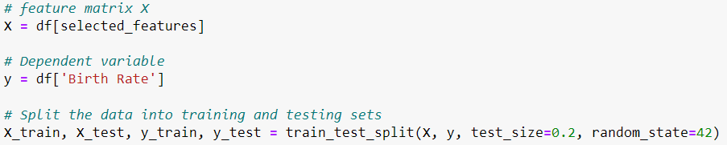

Picking the clusters and random state
The Elbow Method shows the number of clusters and the WCSS
I also choose the best random_state to allow for model reproduction. The silhouette score was around .28, .29

Slide 13
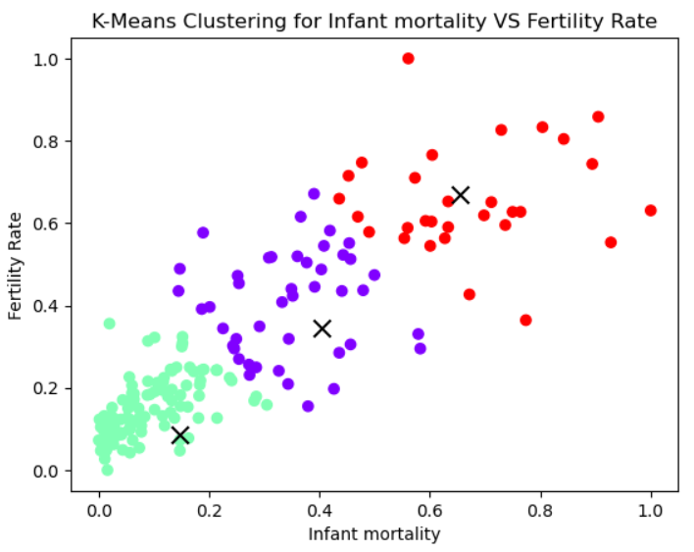
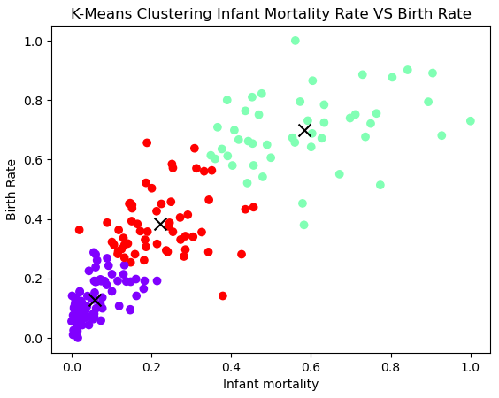
Descriptive Data Mining Method (Clustering Analysis)
Data Mining Project 3

